Slide 1
Distributed File Systems

Slide 2
Learning Objectives
Define the abstraction of files by Operating Systems (OSes) and their (files) manipulation.
Discuss the logical components of a file and file attributes.
Discuss access methods and the major components of a file system.
Describe various file operations and authorization services that are performed on files.
Discuss the role of DFS replication and how its scheduling affects consistency in a distributed system.
Notes:
Students may not know exactly what is meant by globalization or may have an incomplete understanding of the term. You might ask students what they think it means. Potential answers could include: reduction of economic and cultural advantages of developed countries, increased number of companies with operations in multiple countries worldwide, and increased reliance on imports and exports of goods (and jobs). Globalization will be discussed in later slides as well.

Slide 3
File Concept
OS abstracts from the physical storage devices to define a logical storage unit: File
Types:
  Data: numeric, alphabetic, alphanumeric, binary
  Program: source and object form

Slide 4
Access Methods
Sequential access: information is processed in order
  read next
  write next (append to the end of the file)
  reset to the beginning of file
  skip forward or backward n records
Direct access: a file is made up of fixed length logical blocks or records
  read n
  write n
  position to n
  read next
  write next
  rewrite n

Slide 5
Access Methods…
Indexed sequential access:
  Data units are addressed directly by using an index (key) associated with each data block.
  Requires the maintenance of an search index on the file, which must be searched to locate a block address for each access.
  Usually used only by large file systems in mainframe computers.
  Indexed sequential access method (ISAM)
    A two-level scheme to reduce the size of the search index
    Combine the direct and sequential access methods.

Slide 6
Logical Components of a File
File name: symbolic name
  When accessing a file, its symbolic name is mapped to a unique file id (ufid or file handle) that can locate the physical file
    Mapping is the primary function of the directory service.
File attributes – next slide
Data units
  Flat structure of a stream of bytes of sequence of blocks
  Hierarchical structure of indexed records

Slide 7
File Attributes
File Handle: Unique ID of file
Name: only information kept in human-readable form
Type: needed for systems that support different types
Location: pointer to file location on device
Size: current file (and the maximum allowable) size
Protection: controls who can read, write, execute
Time, date, and user identification: data for protection, security, and usage monitoring.
Information about files are kept in the directory structure, which is maintained on the physical storage device.

Slide 8
Major Components in A File System
A file system organizes and provides access and protection services for a collection of files.
Directory Service |  | Name resolution, add and deletion of files
Authorization Service |  | Capability and /or access control list
File Service | Transaction | Concurrency and replication management
 | Basic | Read/write files and get/set attributes
System Service |  | Device, cache, and block management
Table 1-1: Components of a File System

Slide 9
Directory Structure
Access to a file must first use a directory service to locate the file.
A collection of nodes containing information about all files.
Both the directory structure and the files reside on disk.
Directory
F 1
F 2
F 3
F 4
F n
Files
Figure 1-1: Directory Structure

Slide 10
Information in a Directory
Name
Type: file, directory, symbolic link, special file…
Address: device blocks to store a file
Current length
Maximum length
Date last accessed (for archival)
Date last updated (for dump)
Owner ID
Protection information

Slide 11
Operations Performed on Directory
Search for a file
Create a file
Delete a file
List a directory
Rename a file
Traverse the file system

Slide 12

Tree-Structured Directories – Hierarchical Structure of A File System
Subdirectory is just a special type of file…
Figure 1-2: Hierarchical Structure of a File System

Slide 13
Authorization Service
File access must be regulated to ensure security.
File owner/creator should be able to control:
  what can be done
  by whom
Types of access
  Read
  Write
  Execute
  Append
  Delete
  List

Slide 14
File Service – File Operations
Create
  Allocate space
  Make an entry in the directory
Write
  Search the directory
  Write is to take place at the location of the write pointer
Read
  Search the directory
  Read is to take place at the location of the read pointer
Reposition within file – file seek
  Set the current file pointer to a given value
Delete
  Search the directory
  Release all file space
Truncate
  Reset the file to length zero
Open(Fi)
  Search the directory structure
  Move the content of the directory entry to memory
Close(Fi)
  move the content in memory to directory structure on disk
Get/set file attributes

Slide 15
System Service
Directory, authorization, and file services are user interfaces to a file system (FS).
System services are a FS’s interface to the hardware and are transparent to users of FS:
  Mapping of logical to physical block addresses
  Interfacing to services at the device level for file space allocation/de-allocation
  Actual read/write file operations
  Caching for performance enhancement
  Replicating for reliability improvement

Slide 16
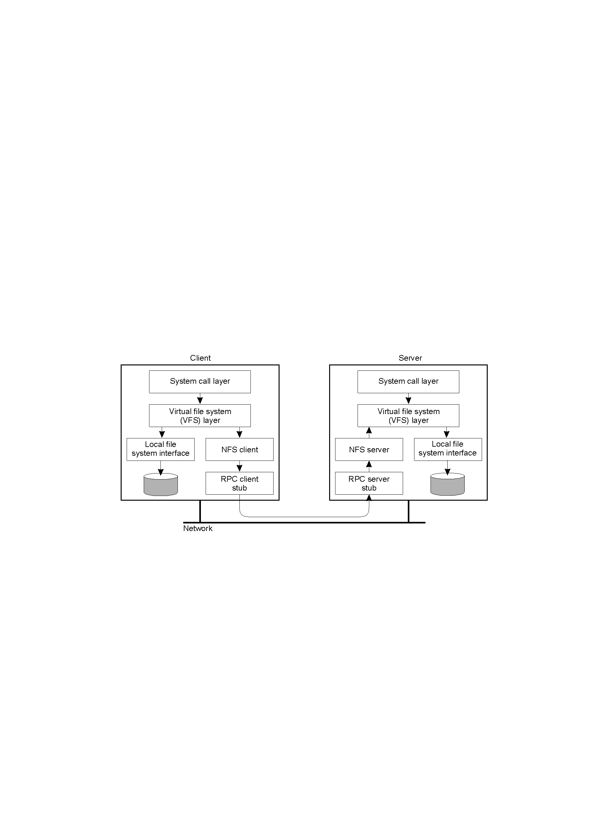
DFS Architecture –
NFS Example
Figure 1-3: Directory Structure
Network File System (NFS): a distributed file system protocol originally developed by Sum Microsystems in 1984, allowing a user on a client computer to access files over a network much like local storage is accessed.
Distributed file system (DFS): used to make files distributed across multiple servers appear to users as if they reside in one place on the network.
Distributed File System (DFS): a technology in the Microsoft shop related to sharing files across networks, specifically across wide area networks.

Slide 17
File Mounting
A useful concept for constructing a large file system from various file servers and storage devices.
Attach a remote named file system to the client’s file system hierarchy at the position pointed to by a path name (mounting point);
  A mounting point is usually a leaf of the directory tree that contains only an empty subdirectory
  mount claven.lib.nctu.edu.tw:/OS /chow/book
Once files are mounted, they are accessed by using the concatenated logical path names without referencing either the remote hosts or local devices;
  Location transparency
  The linked information (mount table) is kept until they are unmounted.

Slide 18
File Mounting Example…
root
root
chow
Export
OS
Mount
paper
book
DFS
DSM
/OS/DSM
DFS
DSM
/chow/book/DSM
Local Client
Remote Server
Figure 1-4: File Mounting Example

Slide 19
File Mounting..
Different clients may perceive a different FS view
  To achieve a global FS view – Systems Admin enforces mounting rules
Export: a file server restricts/allows the mounting of all or parts of its file system to a predefined set of hosts;
  The information is kept in the server’s export file
File system mounting:
  Explicit mounting: clients make explicit mounting system calls whenever one is desired.
  Boot mounting: a set of file servers is prescribed and all mountings are performed the client’s boot time.
  Auto-mounting: mounting of the servers is implicitly done on demand when a file is first opened by a client.

Slide 20
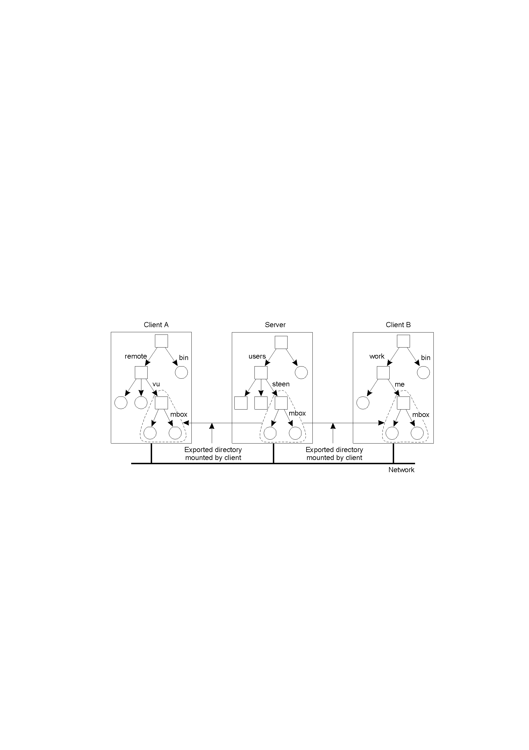
Location Transparency
No global naming
Figure 1-5: Location Transparency

Slide 21
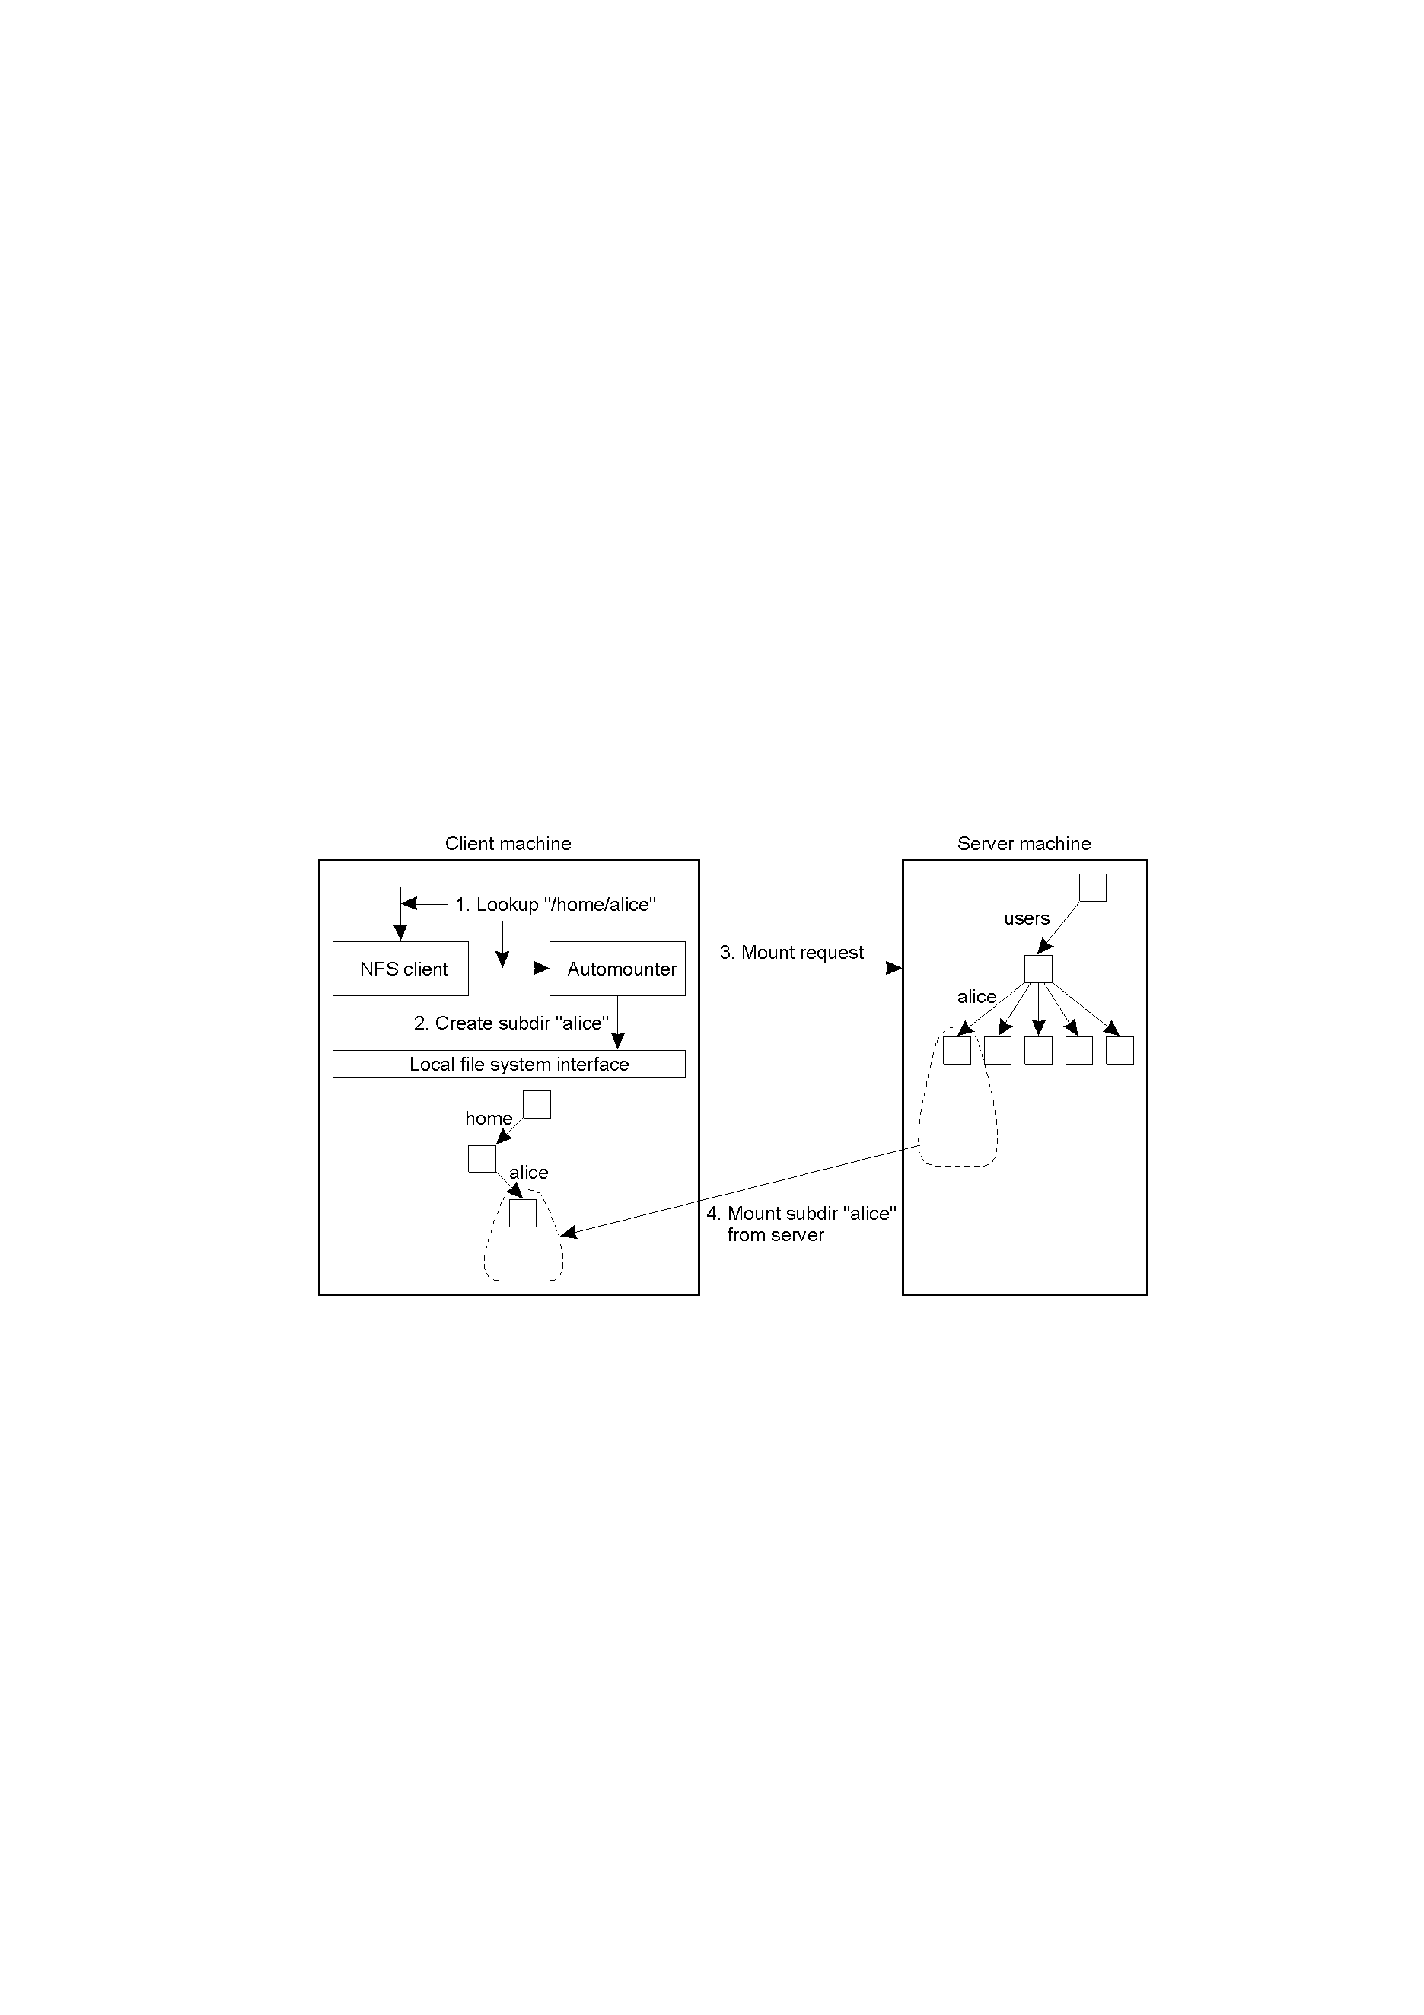
A Simple Automounter for NFS
Figure 1-6: NFS Automounter

Slide 22
Server Registration
The mounting protocol is not transparent – requires knowledge of the location of file servers.
When multiple file servers can provide the same file service, the location information becomes irrelevant to the clients.
Server registration → name/address resolution
  File servers register their services with a registration service, and clients consult with the registration server before mounting.
  Clients broadcast mounting requests, and file servers respond to client’s requests.

Slide 23
Stateful and Stateless File Servers
Stateless file server: when a client sends a request to a server, the server carries out the request, sends the reply, and then removes from its internal tables all information about the request.
  Between requests, no client-specific information is kept on the server
  Each request must be self-contained: full file name and offset…
Stateful file server: file servers maintain state information about clients between requests.
State information may be kept in servers or clients
  Opened files and their clients
  File descriptors and file handles
  Current file position pointers
  Mounting information
  Lock status
  Session keys
  Cache or buffer
Session: a connection for a sequence
of requests and responses between a
client and the file server

Slide 24
A Comparison between Stateless and Stateful Servers
Advantages of Stateless Server | Advantages of Stateful Server
No OPEN/CLOSE calls needed | Better performance
Fault tolerance | Shorter request messages
No server space wasted on tables | Read-ahead possible
No limits on number of open files | Idempotency easier
No problems if a client crashes | File locking possible
Easy to implement | More flexible
Table 1-2: Stateless vs Stateful Servers

Slide 25
Issues of A Stateless File Server
Idempotency requirement
  Is it practical to structure all file accesses as idempotent operations?
File locking mechanism
  Should locking mechanism be integrated into the transaction service?
Session key management
  Can one-time session key be used for each file access?
Cache consistency
  Is the file server responsible for controlling cache consistency among clients?
  What sharing semantics are to be supported?

Slide 26
File Sharing
Overlapping access: multiple copies of the same file;
  Space multiplexing of the file
  Cache or replication
  Coherency control: managing accesses to the replicas, to provide a coherent view of the shared file.
  Desirable to guarantee the atomicity of updates (to all copies)
Interleaving access: multiple granularities of data access operations;
  Time multiplexing of the file
  Simple read/write, Transaction, Session
  Concurrency control: how to prevent one execution sequence from interfering with the others when they are interleaved and how to avoid inconsistent or erroneous results.

Slide 27
Space Multiplexing
Remote access: no file data is kept in the client machine. Each access request is transmitted directly to the remote file server through the underlying network.
Cache access: a small part of the file data is maintained in a local cache. A write operation or cache miss results in a remote access and update of the cache.
Download/Upload access: the entire file is downloaded for local accesses. A remote access or upload is performed when updating the remote file.

Slide 28
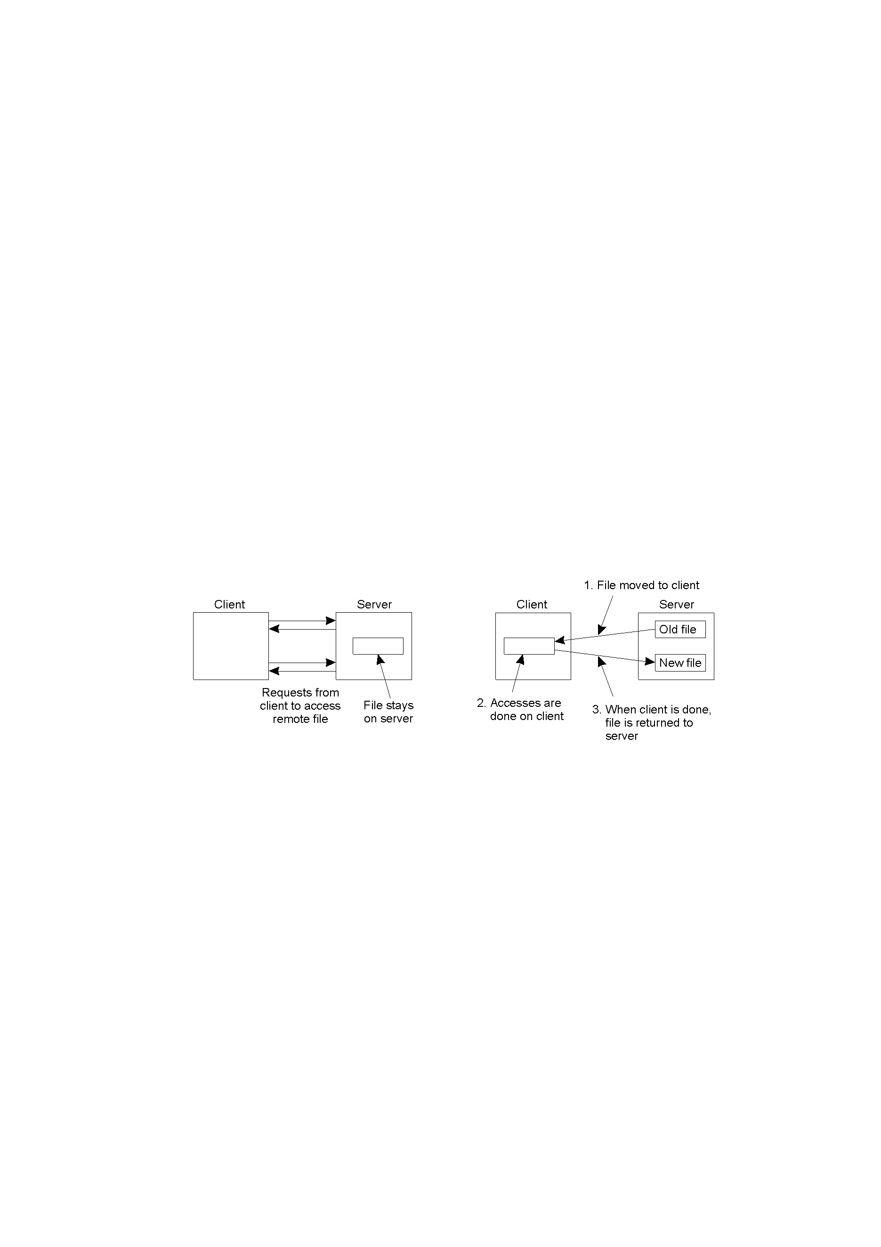
Remote Access vs Download/Upload Access
Remote Access
Download/Upload Access
Figure 1-7: Remote Access vs Download/Upload Access

Slide 29
Four Places for Caching
Client’s disk (optional)
Server’s disk
Client’s
main memory
Server’s
main memory
Client
Server
Figure 1-8: Caching Locations

Slide 30
Coherency of Replicated Data
Four interpretations:
  All replicas are identical at all times
    Impossible in distributed systems
  Replicas are perceived as identical only at some points in time
    How to determine the good synchronization points?
  Users always read the “most recent” data in the replicas
    How to define “most recent”?
      Based on the “completion” times of write operations (the effect of a write operation has been reflected in all copies).
  Write operations are always performed “immediately” and their results are propagated in a best-effort fashion.
    Coarse attempt to approximate the third definition.

Slide 31
Time Multiplexing
Simple RW: each read/write operation is an independent request/response access to the file server.
Transaction RW: a sequence of read and write operations is treated as a fundamental unit of file access (to the same file).
  ACID properties
Session RW: a sequence of transactions and simple RW operations.

Slide 32
Space and Time Concurrencies of File Access
Space Time | Remote Access | Cache Access | Download/Upload Access
Simple RW | No true sharing | Coherency Control | Coherency Control
Transaction | Concurrency Control | Coherency and Concurrency Control | Coherency and Concurrency Control
Session | Not applicable | Not applicable | Ignore sharing
Table 1-3: Space & Time Concurrencies of File Access

Slide 33
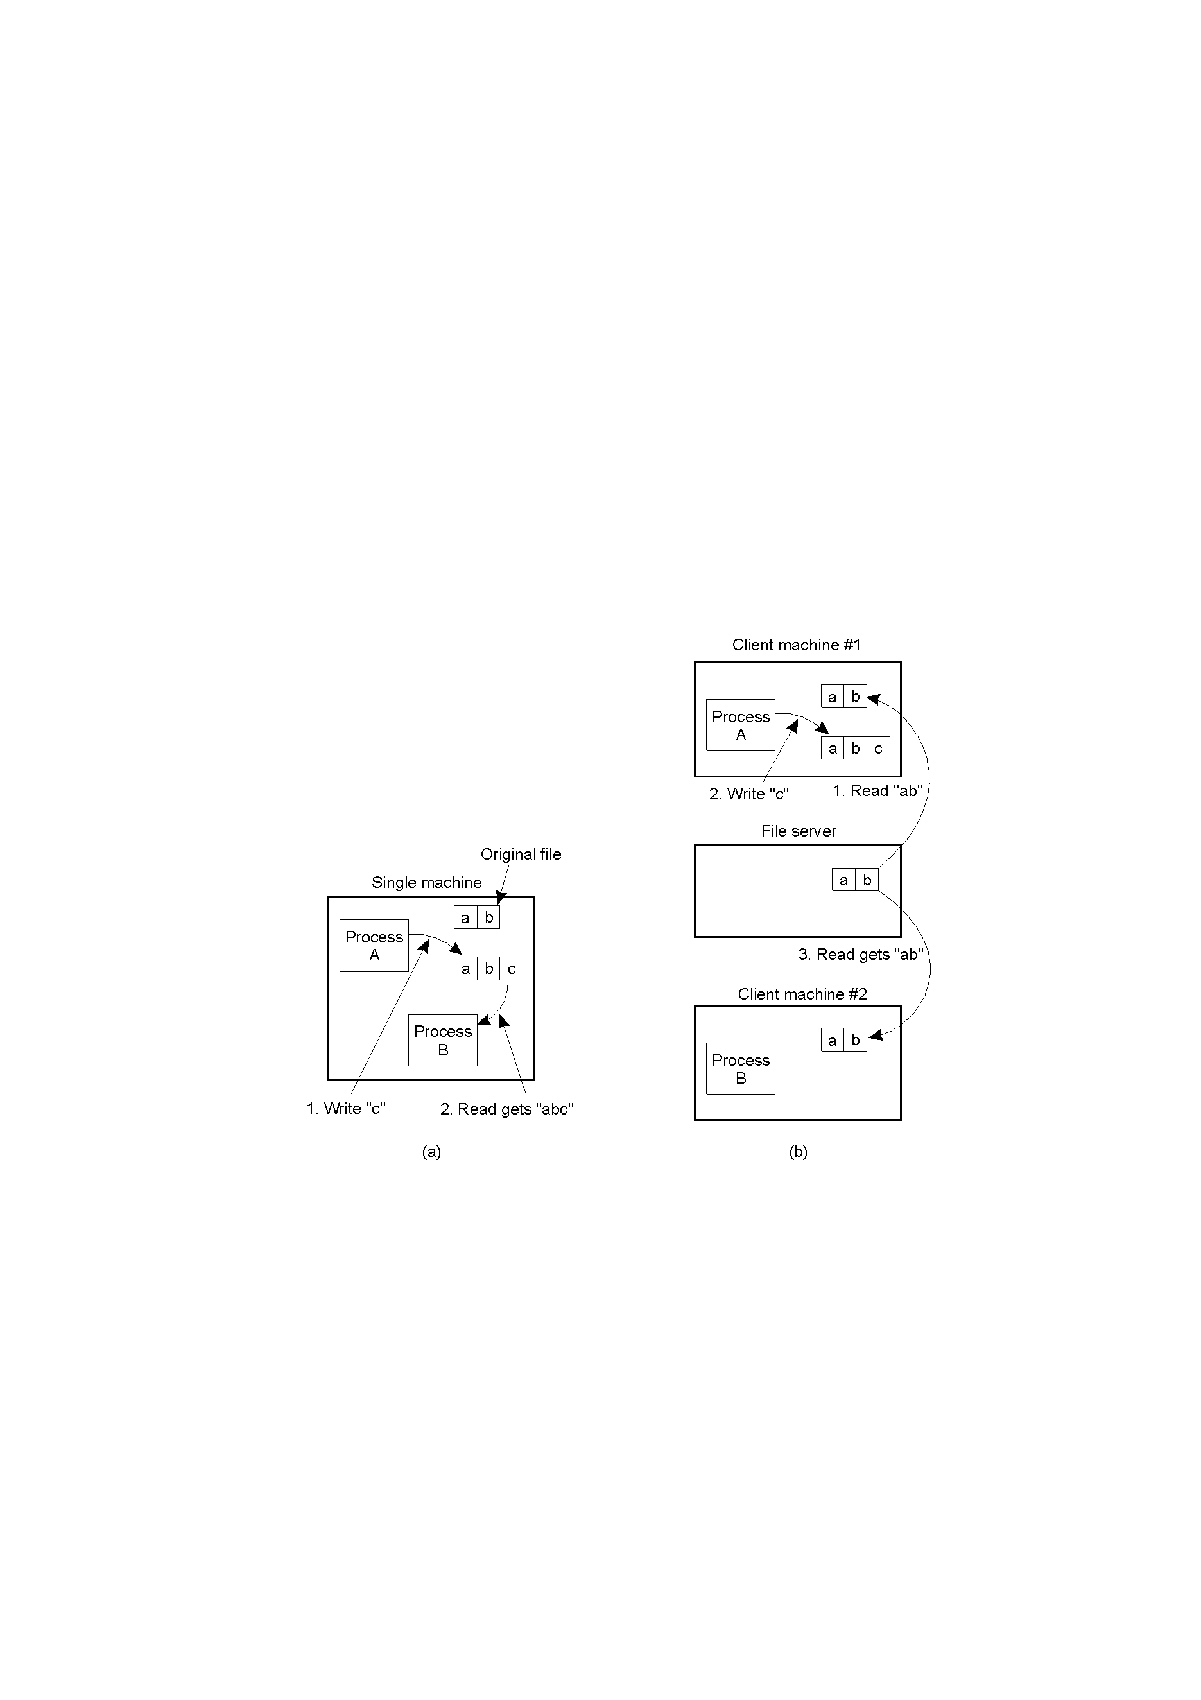
Semantics of File Sharing
(a) On a single processor, when a read follows a write, the value returned by the read is the value just written (Unix Semantics).
(b) In a distributed system with caching, obsolete values may be returned.
Solution to coherency and
concurrency control problems
depends on the semantics of
sharing required by applications.
Figure 1-9: File sharing semantics

Slide 34
Semantics of File Sharing…
Unix Semantics (Currency) | Every operation on a file is instantly visible to all processes. File accesses with a write-through cache and write-invalidation.
Transaction Semantics (Consistency) | All changes have the all-or-nothing property. Update the server at the end of a transaction.
Immutable Files | No updates are possible; simplify sharing and replication
Session Semantics (Efficiency) | No changes are visible to other processes until the file is closed. Update the server at the end of a session.
Table 1-4: Currency, Consistency & Efficiency

Slide 35
Version Control
Version control under immutable files;
  Implemented as a function of the directory service
  Each file is attached with a version number
  An open to a file always returns the current version
  Subsequently read/write operations to the opened files are made only to the local working copy.
  When the file is closed, the local modified version (tentative version) is presented to the version control service.
  If the tentative version is based on the current version, the update is committed and the tentative version becomes the current version with a new version number.
  What is the tentative version is based on an older version…?

Slide 36
Version Control…
Action to be taken if based on an older version…
  Ignore conflict: a new version is created regardless of what has happened (equivalent to session semantics).
  Resolve version conflict: the modified data in the tentative version are disjoint from those in the new current version;
    Merge the updates in the tentative version with the current version to yield to a new version that combines all updates.

Slide 37
Version Control…
  Resolve serializability conflict: the modified data in the tentative version were already modified by the new current version;
    Abort the tentative version and roll back the execution of the client with the new current version as its working version.
    The concurrent updates are serialized in some arbitrary order.
The purpose of a distributed file system e.g. In Windows Server 2003 R2 is to minimize network traffic due to file replication and optimize the administration of shared folders.

Slide 38
Summary
Logical Components of a file
File Attributes
Major Components of a File System
  Directory Service
  Authorization Service
  File Service (Transaction & Basic)
  System Service

Slide 39
Summary…
File Mounting
Stateful & Stateless Servers
File Sharing
  Overlapping Access - Space Multiplexing & Coherency Control
  Interleaving Access - Time Multiplexing & Concurrency Control
Version Control

Slide 40
Recommended Reading…
http://pdos.csail.mit.edu/papers/wheelfs:iptps07/paper.pdf
http://inst.cs.berkeley.edu/~cs262/sp02/Papers/afs.pdf
http://www.cs.cmu.edu/~satya/docdir/satya89survey.pdf

Slide 41
Next Week…
Group Project Presentations
FINAL Exam Preparations

